Slide 1



Predicting Returning Customers
Home
https://shop.merch.google/
Sammy Cayo, Roz Huang, Conor Huh, Jasmine Lau, Diego Moss

Slide 2
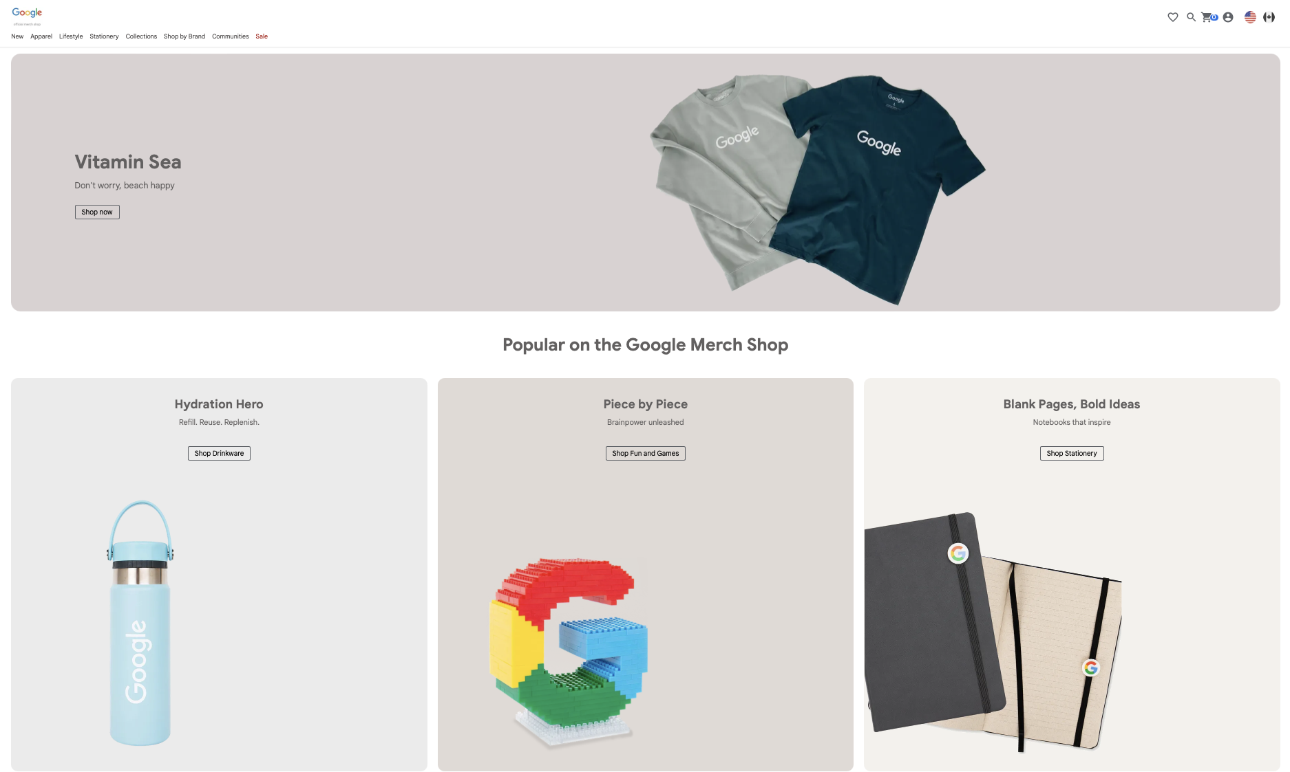
Motivation
Home
Merch
Motivation
https://shop.merch.google/
Goal:
User Retention Prediction
Impact:
Higher conversion rate of ad spend
Challenge:
Implement ML to predict customer return to Google’s online store

Slide 3
BigQuery
Home
Motivation
BigQuery
https://cloud.google.com/bigquery
Data: Aug 1, 2016 - Aug 1 ,2017
366 files
~35 GB of data
Content:
Traffic Source Data
Content Data
Transnational Data
Difficulties:
Kaggle → BigQuery client
Outdated documentation
SQL → Python
API call + query + download = 6+ hrs.
Aug
2016
…
Aug
2017
Notes:
Traffic source data: information about where website visitors originate. This includes data about organic traffic, paid search traffic, display traffic, etc.
Content data: information about the behavior of users on the site. This includes the URLs of pages that visitors look at, how they interact with content, etc.
Transactional data: information about the transactions that occur on the Google Merchandise Store website.

Slide 4



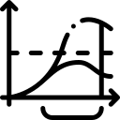
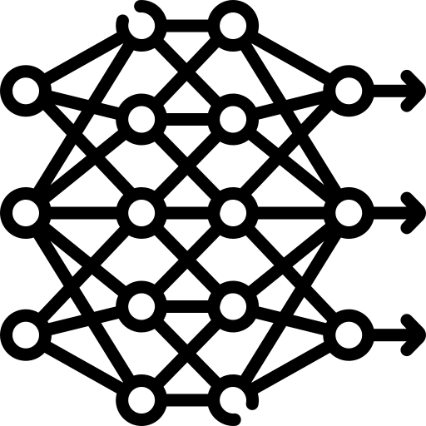
Project Outline
Home
Big Query
Project Outline
Data Querying
Data Processing
Baseline Model
Advanced Model
Output

Slide 5
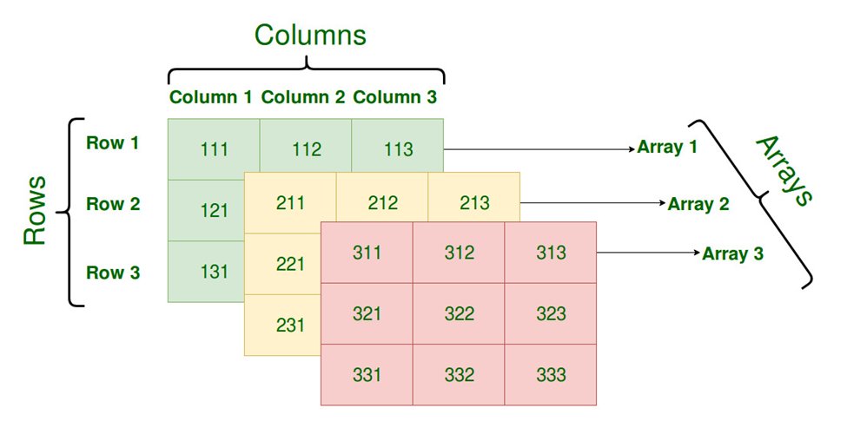
Data
Home
Project Outline
Data
Data Set Overview:
718,161 unique users
566,477 unique users with session data
Data from 13 months (366 days)
Missing Values:
Data was complete except for pieces of session data
ie. If there were no add-to-carts during session
Filled missing data with 0’s
Features
Months
Users
Notes:
Put the exact session data here:
Num Product List Views
Num Product Detail Views
Num Add to Cart
Num Remove from Cart
Num Checkouts
Num Purchase
Num Refunds

Slide 6




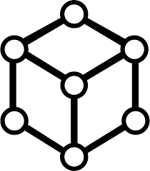



Feature Engineering
Home
Data
Feature Engineering
Non-Stable Features
Stable
Features
User Data
(ex. ID, Date)
Two Sets of Features:
Non-Stable Features:
For each user, their respective features were organized by month.
Non-numeric features such as a users’ location were label encoded using sklearn
Stable Features:
Non Stable Features for each user were averaged across all 13 months.
Summary Data
(ex. Time on Site)
Device Data
(ex. Browser)
Baseline Logistic Regression
Long Short Term Memory (LSTM) Model
Data Reduction
Location Data
(ex. Country)
Queried Data
Non-Stable Features ~960MB
Session Data
(ex. Number of
Add To Carts)
Stable Features ~75MB
~35GB
* Baseline Logit model used only stable features; full description of features used in appendix

Slide 7
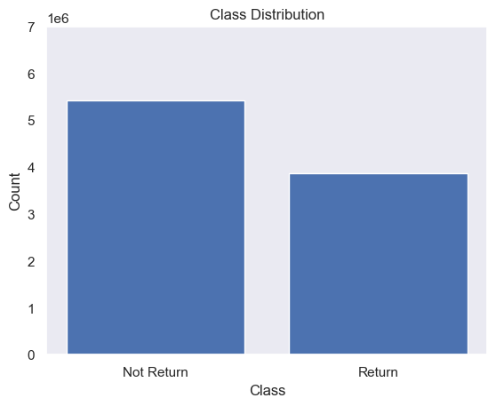
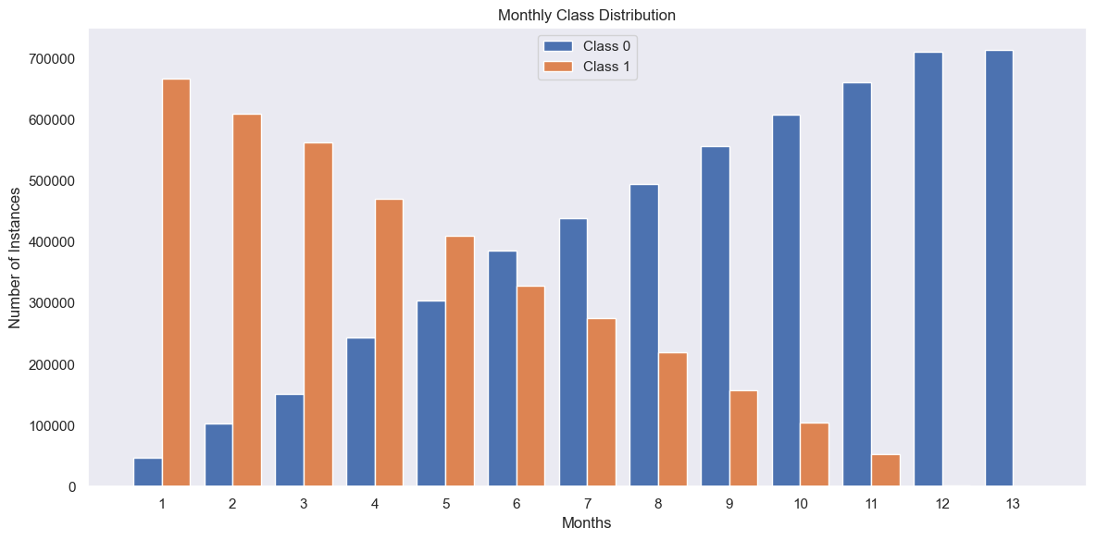
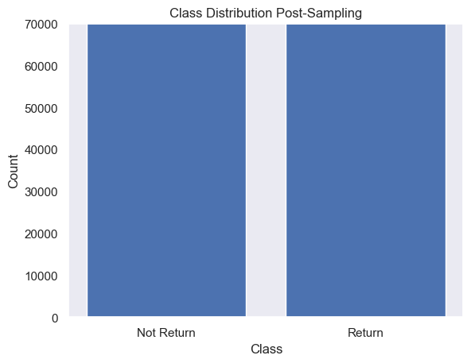
Data Imbalance
Home
Feature Engineering
Data Imbalance

Slide 8
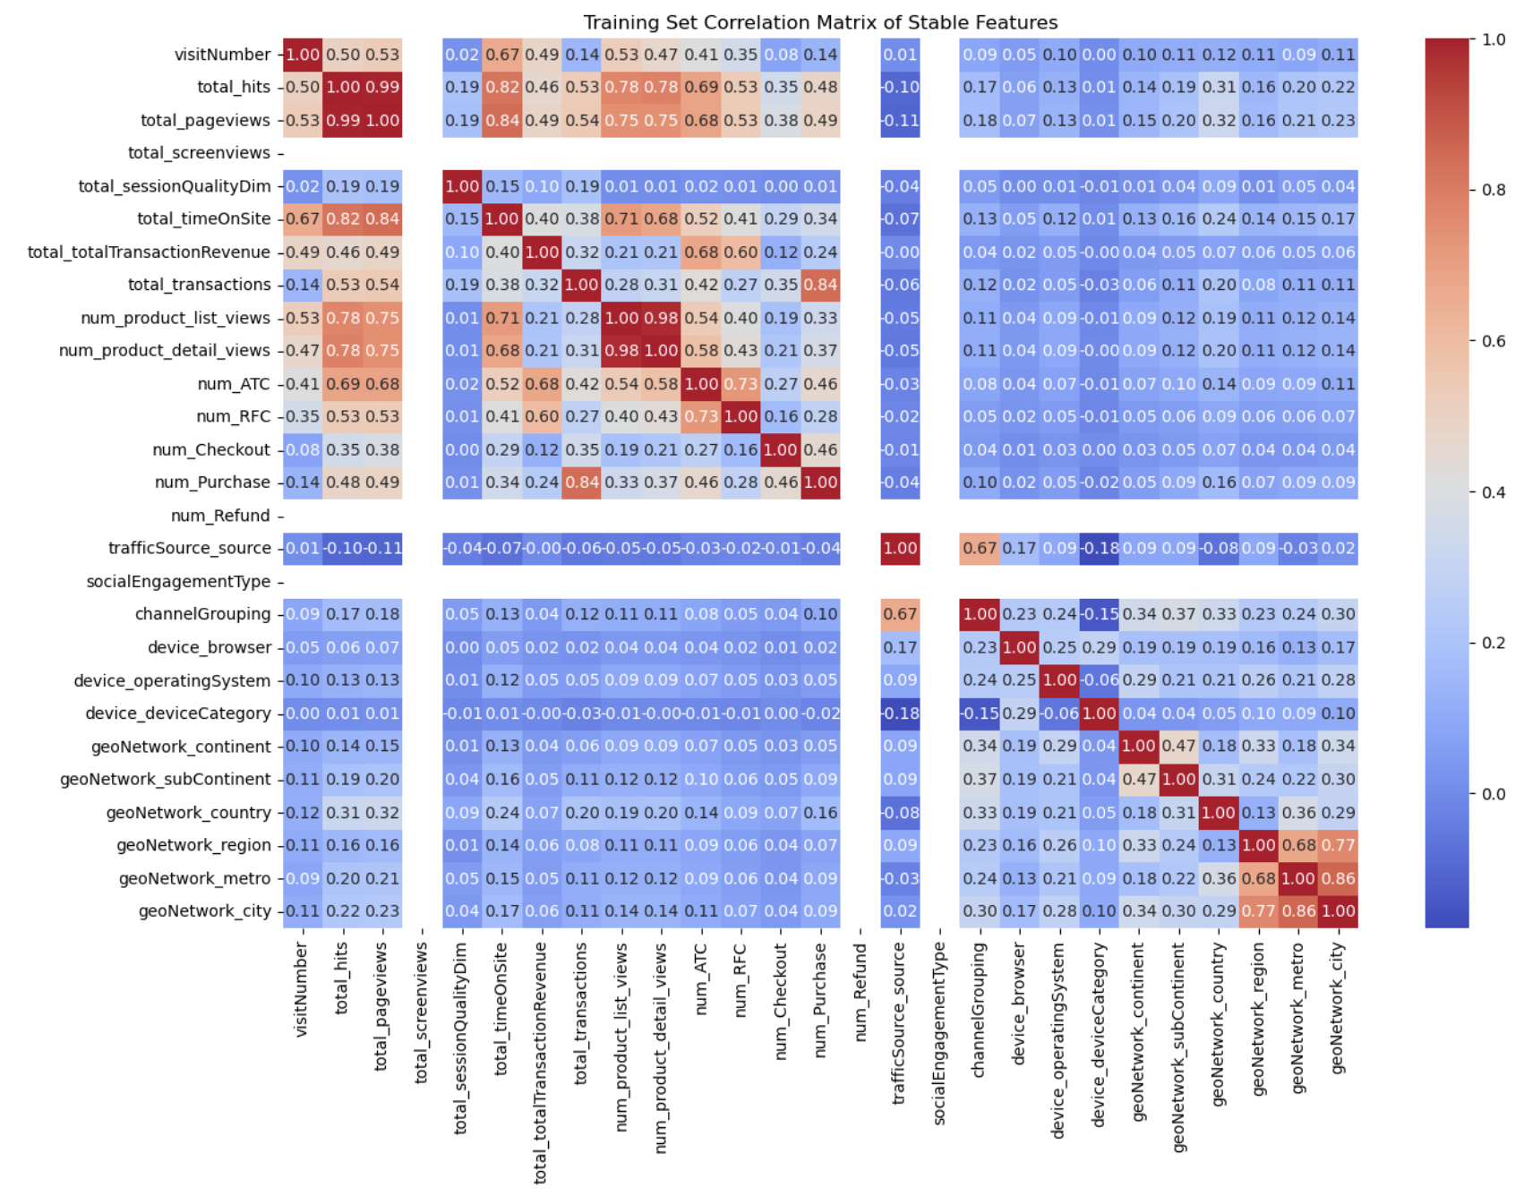
EDA
Home
Data Imbalance
EDA

Slide 9
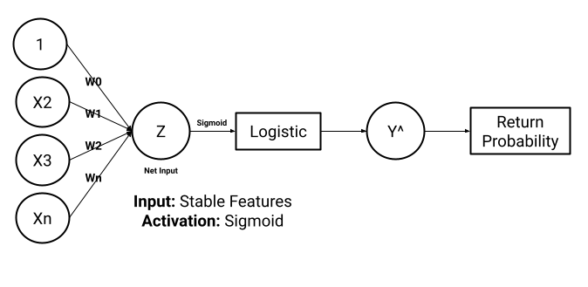
Baseline Model
Home
EDA
Baseline Model
https://carpentries-incubator.github.io/ml4bio-workshop/05-logit-ann/index.html
Layer | Output Shape | Param #
dense (Dense) | (None, 1) | 28
*
Total Parameters: 86
Trainable Parameters: 28
Non-Trainable Parameters: 0
Optimizer Parameters: 58
* ML for Biologists
Notes:
For our baseline model, we implemented logistic regression using only the stable features as our inputs and a sigmoid activation function for binary prediction of user returning or not returning. Our stable feature for each user is:
- number of click through for products.
- number of product detail views
- number of time products are added to cart.
- number of times a product is returned from cart.
- number of refunds
- number of purchases
- AND, number of checkouts
This is meant to be a very simplistic model, as shown in the model summary on the right.
In this Model We have only 86 total parameters and 28 trainable parameters

Slide 10
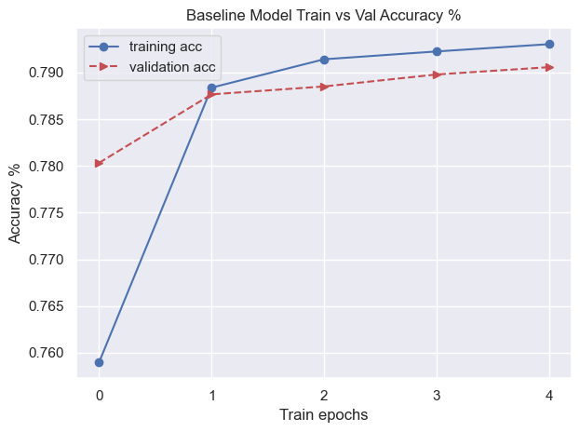
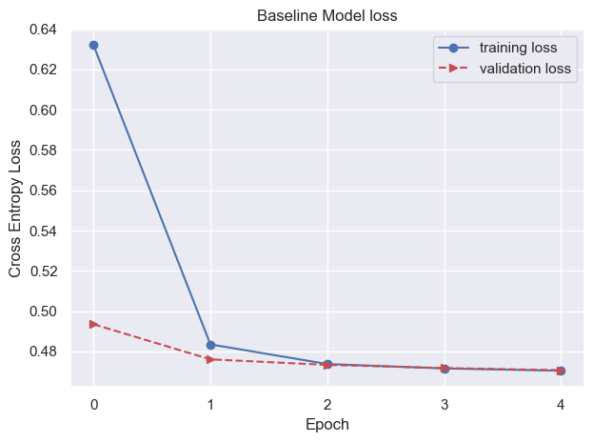
Baseline Model Performance
Home
EDA
Baseline Model
Model | Loss | Accuracy | Precision | Recall
Baseline | 0.470315 | 0.793532 | 0.83964 | 0.725654
Notes:
- Here, we present the performance of our model after training for 5 epochs.
- After the 5th epoch:
o The loss value is about 0.47,
o The accuracy reaches slightly above 79%,
o The training precision, which is the ratio of correctly predicted positive instances to the total predicted positives, is 83.9%,
o Lastly, the Recall, which represents correctly predicted positive instances among all actual positive instances, is 72.5%.

Slide 11
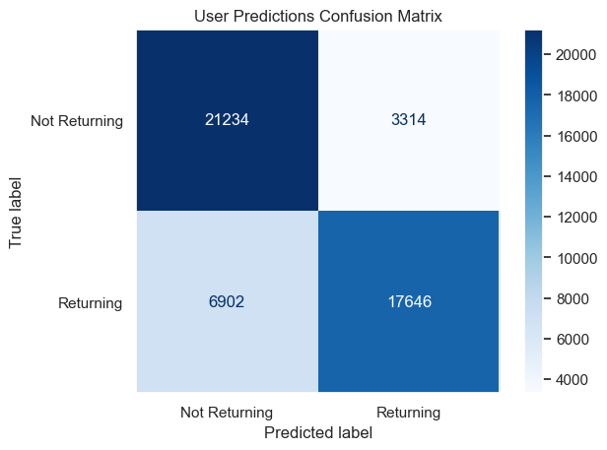
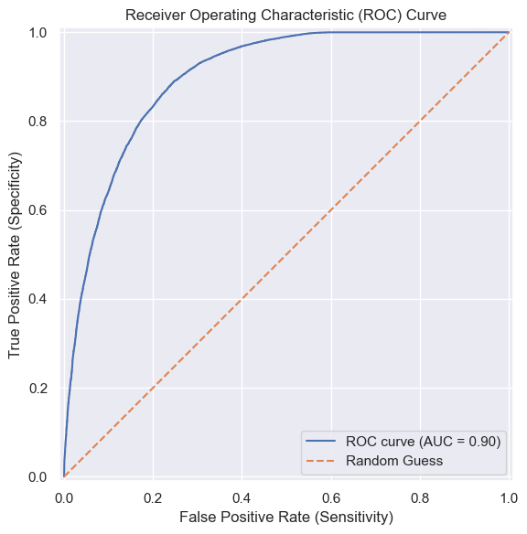
Baseline Model Performance
Home
EDA
Baseline Model
Recall: TP/ (TP + FN)
Precision: TP/ (TP + FP)
Notes:
When we evaluate the baseline model on our test data
We saw descent performance similar to our training data
This is represented in our confusion matrix.
Where our recall is 76.7% and our precision at 75.4%
Our ROC curve to the right represents our model's ability to distinguish between classes. The area under the curve (AUC) is 0.90, indicating that our Baseline model has a high level of performance in differentiating between the positive and negative classes.

Slide 12
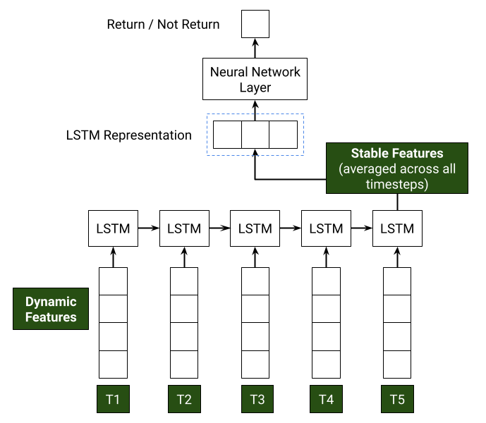
LSTM Model Architecture
Home
Baseline Model
Advanced Model
User Data
Jan
Feb
*
Mar
…
Oct
Nov
Dec
* Wilcox, K., & Wang, L. (2022)

Slide 13
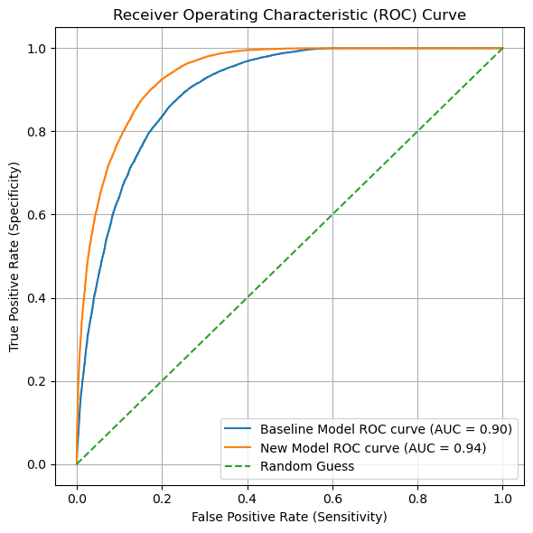
LSTM ROC Model Performance
Home
Baseline Model
Advanced Model
AUC from .90 - .94
Recall from .73 - .93
Notes:
- When we evaluate the model with our test data
o We saw descent performance similar to our training data
o This is represented in our confusion matrix.
Where our recall is 76.7% and our precision at 75.4%

Slide 14
Model Results and Hyperparameter Tuning
Home
Advanced Model
Hyperparameters
drop out rate | dense neurons | lr | train loss | train recall | val loss | val recall
0.2 | None | 0.001 | 0.270952 | 0.913334 | 0.268425 | 0.915902
0.2 | None | 0.0001 | 0.386963 | 0.914186 | 0.385042 | 0.915159
0.2 | None | 0.001 | 0.239962 | 0.913222 | 0.241114 | 0.916109
0.2 | None | 0.0001 | 0.381681 | 0.904108 | 0.380113 | 0.904007
0.2 | 50 | 0.001 | 0.30718 | 0.939715 | 0.307181 | 0.935233
0.2 | 50 | 0.0001 | 0.312531 | 0.930838 | 0.31023 | 0.932425
0.2 | 50 | 0.001 | 0.266768 | 0.957386 | 0.270468 | 0.951425
0.2 | 50 | 0.0001 | 0.306068 | 0.922156 | 0.305149 | 0.922181
0.5 | None | 0.001 | 0.460965 | 0.934927 | 0.463083 | 0.928872
0.5 | None | 0.0001 | 0.381211 | 0.895817 | 0.378881 | 0.89558
0.5 | None | 0.001 | 0.299457 | 0.928521 | 0.297285 | 0.930979
0.5 | None | 0.0001 | 0.379716 | 0.883869 | 0.377461 | 0.884015
0.5 | 50 | 0.001 | 0.298759 | 0.939338 | 0.298797 | 0.937794
0.5 | 50 | 0.0001 | 0.341267 | 0.914255 | 0.338925 | 0.916894
Final Model Test Recall:
93.72%
Final Model Parameter Count:
50,255 params (~197 KB)
Prediction Time (Inference):
~2 ms for one prediction for a user

Slide 15

Conclusions
Home
Hyperparameters
Conclusions
Conclusion:
Identify high-potential customers
Focus marketing efforts
↑ User engagement + ↑ User loyalty
Application:
Managers run model periodically to:
Monitor trends
Optimize resources
Evaluate performance
Improvement Avenues:
Play with hyperparameter sets
↑ Feature engineering
Method of filling NaN’s
Compute metrics
ie. Session quality
Work with stable features
Improve ML fairness
ie. Geographical location
Notes:
Implementing this predictive model will enable the Google Merchandise Storefront to identify customers who are likely to return. By focusing marketing efforts and personalized retention strategies on these high-potential customers, the store can enhance user engagement and loyalty. This targeted approach leads to a higher conversion rate of ad spend, ensuring that marketing investments are directed towards the most promising segments.

Slide 16
NeurIPS Checklist
Home
Conclusion
NeurIPS
https://neurips.cc/Conferences/2021/PaperInformation/PaperChecklist
D
D
D
D
D
D
D
Did you report error bars? NA
Did you include the amount of compute and the type of resources used? NO
If your work uses existing assets, did you cite the creators? YES
Did you mention the license of the assets? YES
Did you include any new assets either in the supplemental material or as a URL? NA
Did you discuss whether and how consent was obtained from people whose data you're using/curating? NA
Did you discuss whether the data you are using/curating contains personally identifiable information or offensive content? NA
If you used crowdsourcing or conducted research with human subjects…? NA
Do the main claims made in the abstract and introduction accurately reflect the paper's contributions and scope? YES
Have you read the ethics review guidelines and ensured that your paper conforms to them? YES
Did you discuss any potential negative societal impacts of your work?
Our project has no direct paths to negative outcomes when used as intended
Did you describe the limitations of your work? YES
If you are including theoretical results…? NA
Did you include the code, data, and instructions needed to reproduce results? YES
Did you specify all the training details? YES
Notes:
Our project aligns with the NeurIPS checklist, with some questions not applying to our project design. We do not believe that our project has any direct negative outcomes if used as intended, and we had not discussed compute and resources used because had felt this was not necessary. If these topics need to be further addressed, we are welcome to open a discussion during Q and A

Slide 17
Q & A
Home
NeurIPS
Questions

Slide 18
thank you
Home
Questions
Thank You

Slide 19
Appendix
Home
Questions
Appendix

Slide 20
Contributions
Home
Appendix
Contributions
 | Jasmine Lau | Diego Moss | Roz Huang | Conor Huh | Sammy Cayo
Data Querying | X |  |  | X
EDA |  |  | X
Data Cleaning / Splitting |  | X | X | X
Feature Engineering |  |  |  | X
Modeling |  | X |  |  | X
Presentation Slides | X | X | X | X | X
Notes:
We can created a table for contributions
Each column is a group member name

Slide 21
Feature Engineering (Details)
Home
Contributions
Feature Engineering
Feature | Description
fullVisitorId | The unique visitor ID.
visitNumber | The session number for this user. If this is the first session, then this is set to 1.
date | The date of the session in YYYYMMDD format.
total_hits | Total number of hits within the session.
total_pageviews | Total number of pageviews within the session. (desktop only field)
total_screenviews | Total number of screenviews within the session. (mobile only field)
total_sessionQualityDim | An estimate of how close a particular session was to transacting, ranging from 1 to 100.
total_timeOnSite | Total time of the session expressed in seconds.
total_totalTransactionRevenue | Total transaction revenue
total_transactions | Total number of ecommerce transactions within the session.
trafficSource_source | Traffic Source from which the session originated.
socialEngagementType | Engagement type, either "Socially Engaged" or "Not Socially Engaged".
channelGrouping | The Default Channel Group associated with an end user's session for this View.
device_browser | The browser used (e.g., "Chrome" or "Firefox").
Feature | Description
device_operatingSystem | Device
device_deviceCategory | The type of device (Mobile, Tablet, Desktop).
geoNetwork_continent | The continent from which sessions originated, based on IP address.
geoNetwork_subContinent | The sub-continent from which sessions originated, based on IP address of the visitor.
geoNetwork_country | The country from which sessions originated, based on IP address.
geoNetwork_region | The region from which sessions originate, derived from IP addresses.
geoNetwork_metro | The Designated Market Area (DMA) from which sessions originate.
geoNetwork_city | Users' city, derived from their IP addresses or Geographical IDs.
num_product_list_views | Number of times a user views a product list
num_product_detail_views | Number of times a user views a product detail page
num_ATC | Number of Add To Carts
num_RFC | Number of Removes from Cart
num_checkout | Number of Checkouts
num_purchase | Number of Purchases [0,1]
num_refunds | Number of Refunds [0,1]
Notes:
Clean up the feature excel sheet and move to appendix
Total Data Reduction:
35GB -> 1.03 GB
73.6MB Stable Features
956.8MB Features
Make the bullet points shorter and talk track
29 Total Features in 6 categories:
User Data
Summary Level Data (totals)
device data
location data
session data
Organized into Monthly Features & Stable Features (Aggregated features per user across all months)

Slide 22
Home
Feature Engineering
GitHub
https://github.com/Mossd-2/DATASCI-207-Applied-Machine-Learning
GitHub Project Repo

Slide 23
Works Cited
Home
Github Repo
Citations
Data from: https://bigquery.cloud.google.com/table/bigquery-public-data:google_analytics_sample.ga_sessions_20170801
License: CC0: Public Domain
“Logistic Regression, Artificial Neural Networks, and Linear Separability.” Logistic Regression, Artificial Neural Networks, and Linear Separability – Machine Learning for Biologists, carpentries-incubator.github.io/ml4bio-workshop/05-logit-ann/index.html. Accessed 5 Aug. 2024.
Wilcox, K., & Wang, L. (2022). Jointly Modeling Participant-Level Data and Summary Statistics for Treatment Differences. Multivariate Behavioral Research, 57, 175 - 176. https://doi.org/10.1080/00273171.2022.2030204.

Slide 24
Graveyard
Home
Citations
Graveyard

Slide 25
Credits.
Presentation Template: SlidesMania
Images: Unsplash
Fonts used in this presentation: Roboto and Lexend Deca
Need help editing this template? Check out this video

Slide 26
Editable Icons

